Slide 1
An Introduction to LEGO® Serious Play
HAWAII ASTD CHAPTER
Tuesday, July 30, 2013
Debbie Powell, M.A.
Certified LEGO® Serious Play Facilitator

Slide 2
What is the LEGO® Serious Play Method?
A facilitated thinking, communication and problem-solving technique for organizations, teams and individuals
Draws on extensive research from the fields of business, organizational development, psychology and education
The methodology is based on the Core Process and the seven Application Techniques

Slide 3
LSP Fundamental Beliefs about Leadership and Organizations
Leaders don’t have all of the answers. Their success is dependent on hearing all voices in the room
People naturally want to contribute, be part of something bigger and take ownership
Allowing each member to contribute and speak out results in a more sustainable business model
All too often, teams work sub-optimally, leaving valuable team member knowledge untapped
We live in a world, which can best be described as complex and adaptive

Slide 4
Why use the LEGO® Serious Play Method?
Taps into the human ability to imagine, to describe and to make sense of a situation at hand, to initiate change and improvement and even to create something radically new
Levels the playing field, engaging 100% attention and participation
The Power of Hand Knowledge – our hands are connects to 70-80% of our brain cells. We know a lot more than we think we know at any given moment
Communicate in 3D to secure fast understanding, constant focus, and efficient decision-making

Slide 5
THE PROCESS
The facilitator will ask the questions and you will answer by building a story with your LEGO bricks
Everyone will build individually and quietly
Trust the process to give meaning to the model as you build
You will share with your table group the story in your model
Group reflection time, insights, patterns

Slide 6
Challenge 1
Start with the black plate at the bottom
Use only yellow and green materials
Build individually
Finish with the flag on top
Make it entirely as you want
You have 4 minutes
If it is a tower to YOU, then it is a tower to us as well
BUILD A TOWER

Slide 7
Challenge 1
Go around the table and introduce yourself (name and organization) and . . .
Share a few words about your tower
SHARING
THE
STORY

Slide 8
Challenge 1
What do you notice about the towers?
REFLECTION

Slide 9
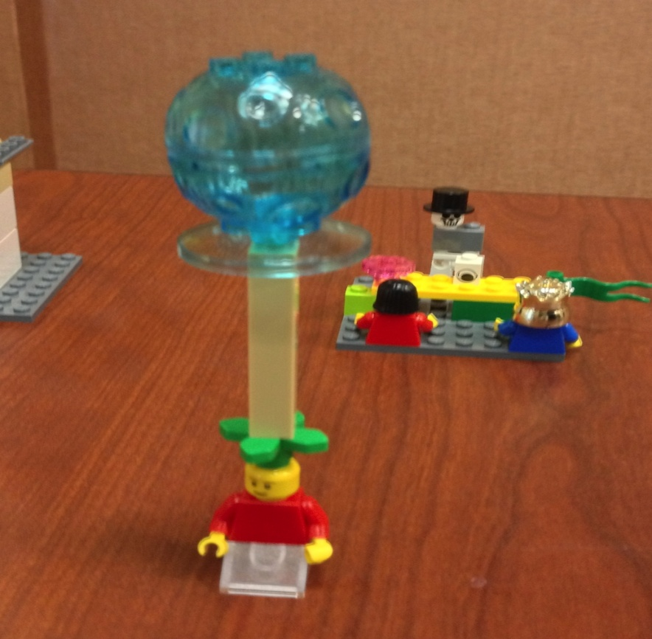
BUILDING TIPS
Don’t have a meeting with yourself, just start building
Trust your hands, let them pick the bricks they want
When you tell your story, the meaning will emerge
Don’t get bogged down in the design

Slide 10
Challenge 2
Pick a model to build from the model sheet or something that looks a little like one of them
Don’t take any of your models apart
When done, wait for more directions – 4 minutes
BUILD FROM THE MODEL SHEET

Slide 11
Challenge 2
Take your model as it is or modify it, so you can use it to tell the group about your vision of a vibrant and dynamic learning & development community
4 minutes
MODIFY
YOUR
MODEL

Slide 12
Challenge 2
Do you have any questions about any of the models?
Or insights about the stories?
REFLECTION

Slide 13
Challenge 3
As a group, place all of your models in a landscape configuration on your table, so that you can create a super story of a vibrant and dynamic learning & development community. 7 minutes
THE BIGGER PICTURE

Slide 14
Challenge 3
Check with your table group to ensure everyone is comfortable with the group story
Select a spokesperson to share your group story with the larger group
THE BIGGER PICTURE

Slide 15
LEGO Serious Play Benefits
More Participation
More Ideas
More Passion
More Ownership & Commitment
Better Results

Slide 16
THANK YOU!
Thank you for participating in this LEGO Serious Play Introductory Session
For more information about booking a LEGO Serious Play event for your organization contact Debbie Powell at dpowell628@gmail.com or cell 808.221.9339

